Slide 1
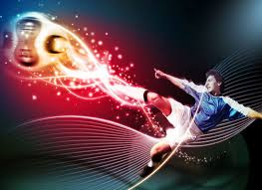
Soccer / Football
Achievement Standard 1.4
Exposing the Truth
Soccer / Football and the influence of commodification and advertising on society

Slide 2
What are we looking at
We are looking at Soccer Football and the influence / effect of commodification and advertising on society.
Picture – David Beckham net worth of $300 million euros. He makes 49 million a year of which only 12million is his pay the rest comes from sponsors

Slide 3
So for your logs
INFLUENCE
=
Advertising
THEME
=
Commodification

Slide 4
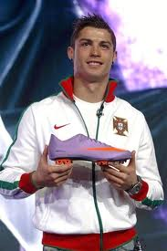
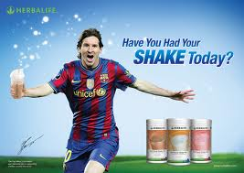
What is Advertising
Advertising – drawing the attention of the public to a product through many forms of media.
E.g.
TV
Billboards
Internet
Celebrities
Footballs big sellers:
David Beckham, Lionel Messi, and Chrisitiano Ronaldo.

Slide 5
What is Commodification?
Commodification – means turning something commercial. Be it Person, product or both
Commercial – means able to make a profit (money)
And we are looking at how this is done through football, more specifically advertising in football and the influence it has on you and others.

Slide 6
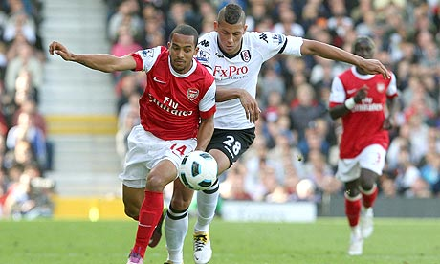
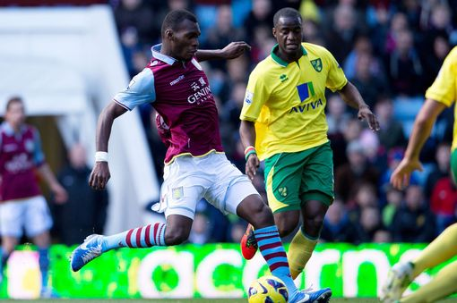
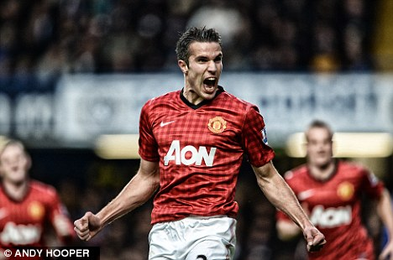
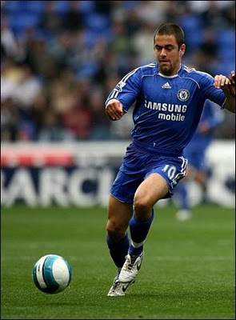
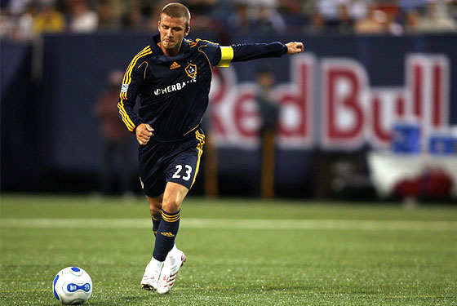

Slide 7
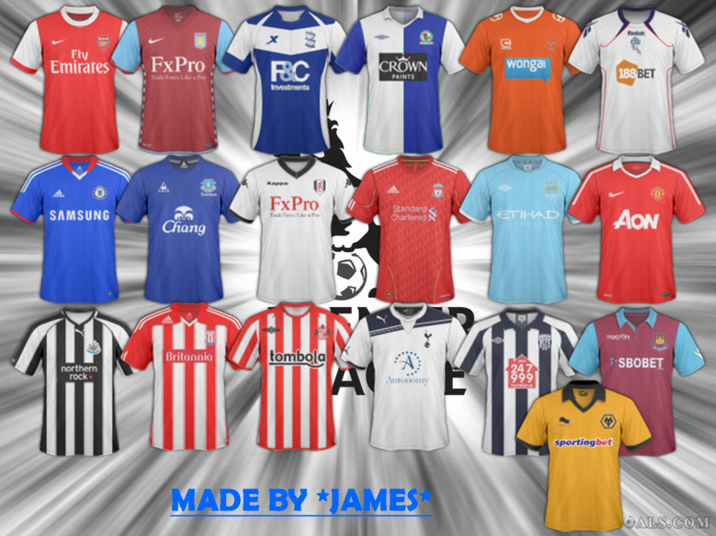
Advertising and Football
So many companies want to advertise their products and services during the game of Football because it is one of the highest watched sports in the world.
They can do it through:
Team Sponsorship
Stadium Sponsorship
Signage at the Stadiums
Adverts during the game
Ads in the programme
Messages on the billboards
Etc
It is believed that a club like Manchester United has 75 million fans worldwide. That means that any advertising that is seen on tv (either ads or banners etc) will reach around 100 million people worldwide.

Slide 8
Advertising and Football
In 2006 AIG signed with Manchester United for 4 years costing £56.5million to be paid over that time.
Now Insurer Aon pays $31 million a year to put its name on the team’s jerseys in a deal that runs through 2014.
Nike is their official sportswear partner ($39million per year), Budweiser is the official beer Betfred are the official betting partners and Key 103 is the official radio station.
DHL Express inked a four-year deal with the club worth a reported $62 million to sponsor Manchester United’s practice jerseys.
In 2004 Manchester United reported a operating profit of £58.3m - not including the cost of player transfers – thanks to strong sales of replica shirts and other merchandise.
So how does this influence us?
What does this mean for participation in Football?

Slide 9
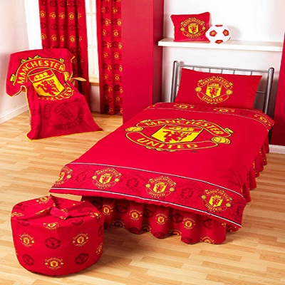
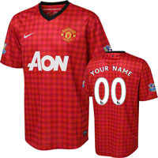
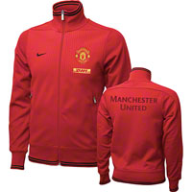
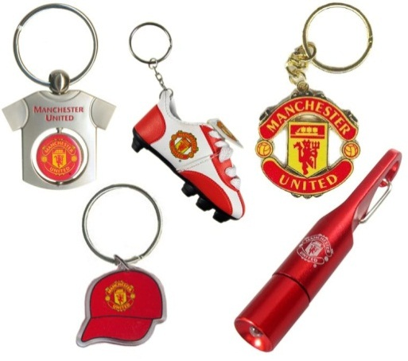
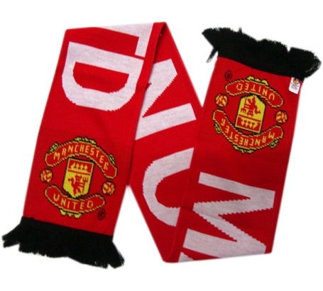
Merchandise and Football
Last year Manchester United made $100million in Merchandise alone.
Each year fans feel they MUST by the new strip for the team.

Slide 10
Video

Slide 11
What is Advertising in football and its influence on society?
Advertising
Influence on society

Slide 12
What is Advertising in football and its influence on society?
Advertising
Equipment
Brands
Players
.
.
.
.
Just remember that you are not limited to what you see on a football field. What else can you come up with?
Influence on society
Public buy the better products. Why?
Public buy the products associated with their favourite players / leagues. Why?
Players are paided by companies to advertise there product. As a result people……?

Slide 13
Who is Advantaged and Disadvantaged by Advertising in football
Advantaged (Why? Provide example)
Businesses (They promotes their products for public to buy. Adidas, Nike etc produce boots, jerseys for sale)
Public get to wear their favourite teams gear or use a product that celebrities use. Beckham drinks Pepsi, as a result people drink Pepsi as they have seen Beckham doing it. Relates back to first point.
What other points can you come up with in your groups?
Disadvantaged (Why? Provide an example)
Not so popular players, Paul Ifill, doesn’t get opportunity to promote products because companies have more popular players that would sell more product for them.
People who can’t afford the products advertised. A top line pair of football boots sell for $300. Finish this answer ……………
What other points can you come up with in your groups?

Slide 14
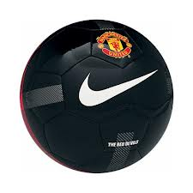
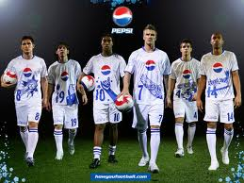
How does this influence happen?
How does advertising happen in football?
What different forms of advertising (answer to first point) have you seen that promotes soccer football?
How does advertising in soccer football try to influence the general public? Why?
What age do they target? Why?
Watch advertisements on shared drive.

Slide 15
Provide any examples you can think of where soccer football is advertised in New Zealand. Playing or Watching.
Where have you seen these advertisements? Try to be specific.
Where do you think football advertising would be more effective? Around the world? Why?

Slide 16
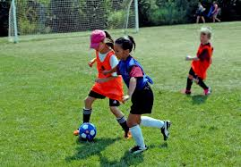
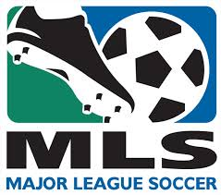
What changes could be made to commodification and advertising in football?
Appeal to a wider range of consumers.
How?
Create lower costing products.
What would this achieve?
……………..
………………

Slide 17
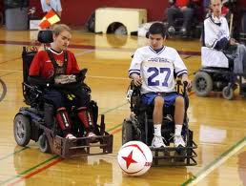
What are the influences of advertising/commodification (positive or negative) on you?
Use the points you have made on the previous slide to construct your answer.
If I cant afford gear I’.m not likely to play football.
Compare yourself to rich, kids, disabled. Do products appeal to them? Why?
Any other points……..

Slide 18
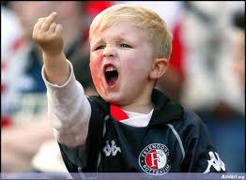
How could you influence change
Hard because you have limited resources, the most significant being money.
Because of the global game it is also difficult because FIFA (world governing body) has final say regardless of how much money you have, or how powerful a club you are. So you could imagine that a Year 11 student at CHS would do nothing…
However
They one thing you could do would be to promote your teams sponsors at school. Having sponsors days where you promote their product to the student body. This would then perhaps generate interest in your team and the teams sponsors.

